Slide 1
PDF ExtentReport for Cucumber and TestNG
We want to add screenshots of failed tests to the Extent Report Version 5.
Step 1 – Add Screenshot configuration in extent.properties
extent.reporter.spark.start=true
extent.reporter.spark.out=Reports/Spark.html
#FolderName
basefolder.name=ExtentReports/SparkReport_
basefolder.datetimepattern=d_MMM_YY HH_mm_ss
#Screenshot
screenshot.dir=/Screenshots/
screenshot.rel.path=../Screenshots/

Slide 2
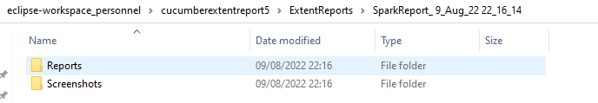
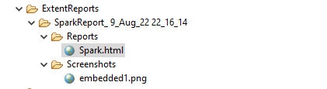
In the above example, we have provided the name “ExtentReports/SparkReport_”. It means that a folder starts with the name “SparkReport_” under the “ExtentReports” folder. The date-time pattern we have provided in another format is the basis of a valid pattern. It will concatenate with the folder name to generate a unique folder for each execution.
As seen in the image above, the “Reports” and “Screenshots” folders get created inside the new folder of SparkReports_. If we look inside the folder, we can see that the report generates.
We can browse the screenshot folder to see all the screenshots taken during each step. Additionally, screenshots will be generated and named automatically.

Slide 3
Step 2 – Add a method to capture the screenshot
@After
public static void tearDown(Scenario scenario) {
//validate if scenario has failed
if(scenario.isFailed()) {
final byte[] screenshot = ((TakesScreenshot) HelperClass.getDriver()).getScreenshotAs(OutputType.BYTES);
scenario.attach(screenshot, "image/png", scenario.getName());
}
In the preceding example, the tearDown() method accepts a Scenario type object. The Scenario can be found within the io.cucumber. We used Selenium’s standard screenshot feature within the method. As an example, we’d like to read the file as a byte[] type. As a parameter, the attach method accepts byte[] type objects. Scenario.attach also includes a screenshot with each step of the scenario.
The updated Hooks class will be as shown below:

Slide 4
import org.openqa.selenium.OutputType;
import org.openqa.selenium.TakesScreenshot;
import com.example.utils.HelperClass;
import io.cucumber.java.After;
import io.cucumber.java.Before;
import io.cucumber.java.Scenario;
public class Hooks {
@Before
public static void setUp() {
HelperClass.setUpDriver();
}
@After
public static void tearDown(Scenario scenario) {
//validate if scenario has failed
if(scenario.isFailed()) {
final byte[] screenshot = ((TakesScreenshot) HelperClass.getDriver()).getScreenshotAs(OutputType.BYTES);
scenario.attach(screenshot, "image/png", scenario.getName());
}
HelperClass.tearDown();
}
}

Slide 5
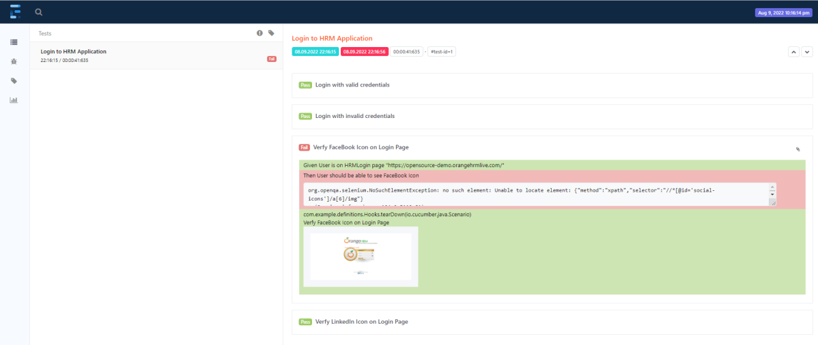
Let’s open the report and view the report. As you can see, besides the scenario, an attachment sign is available, which means something attaches to the scenario. As we have only one failed step, only one screenshot has been captured, as seen in the above image. Right-click on Spark.html and select Open with Web Browser.

Slide 6
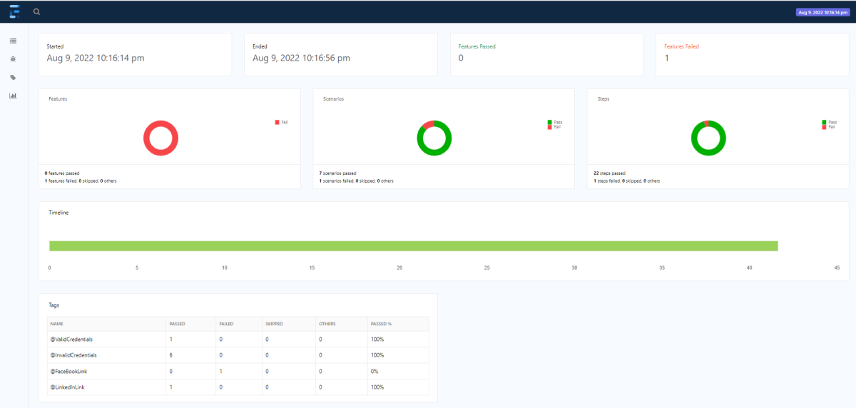
The report also has a summary section that displays the summary of the execution. The summary includes the overview of the pass/fail using a pictogram, start time, end time, and pass/fail details of features as shown in the image below.

Slide 7
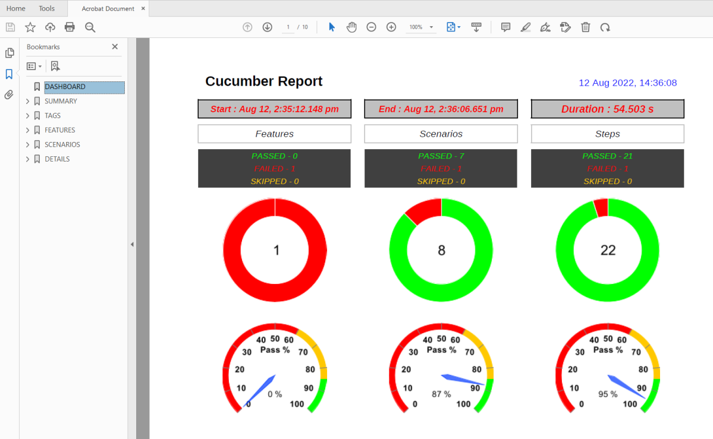
The report contains six sections – dashboard, summary, tags, features, scenarios, and detailed sections.
1. Dashboard
This section is a single-page dashboard that summarizes the test run. This contains the report title, duration, and status of breakups.

Slide 8
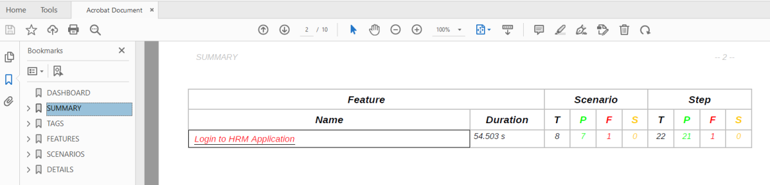
2. Summary section
This section provides an overview of the test run in terms of a feature breakdown, comprising duration, scenario count, and step count. The scenarios and steps are divided into status counts. The feature name has a link that navigates to further details in the detailed step section. This link is only present if the detailed section is enabled.

Slide 9
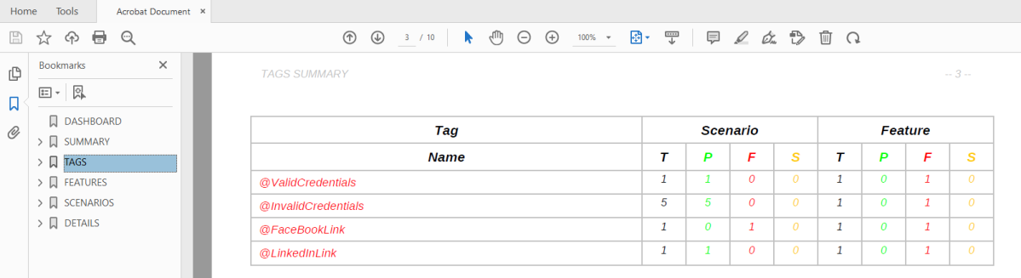
3. Tag section
This section provides an overview of the test run in terms of a tag breakdown, comprising feature count and scenario count.

Slide 10
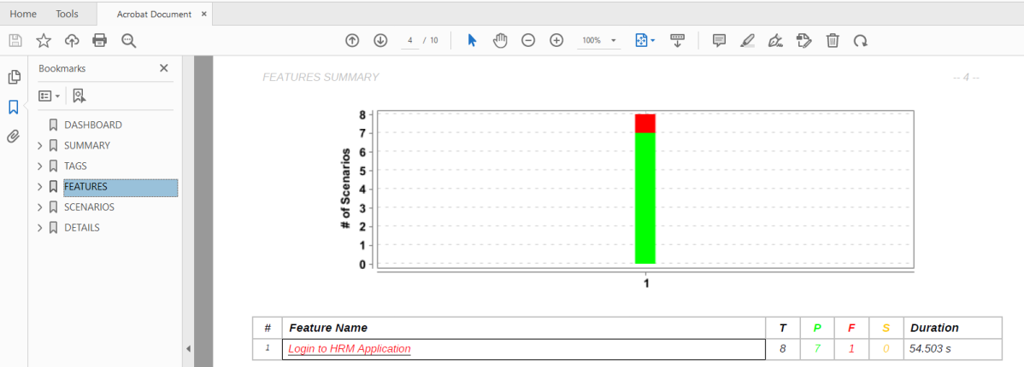
4. Feature section
This section describes the feature details with a stacked bar chart and a table of the scenario status and duration. This section display can be controlled by a configuration setting, enabled by default. The feature name has a link that navigates to further details in the detailed step section. This link is only present if the detailed section is enabled.

Slide 11
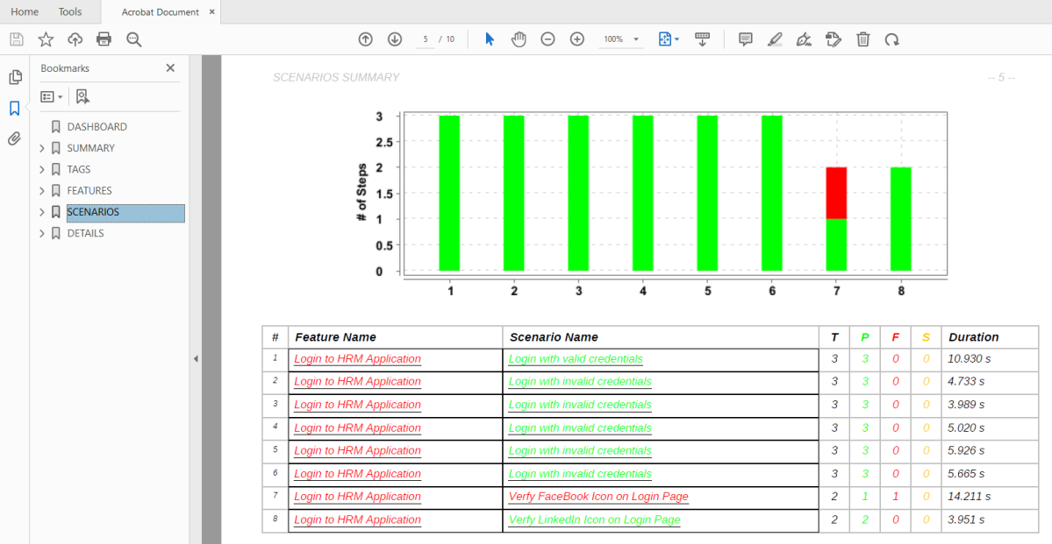
5. Scenario section
This section describes the scenario details with a stacked bar chart and a table of the step status and duration. This section display can be controlled by a configuration setting, enabled by default. The feature and scenario names have a link that navigates to further details in the detailed step section. This link is only present if the detailed section is enabled.

Slide 12
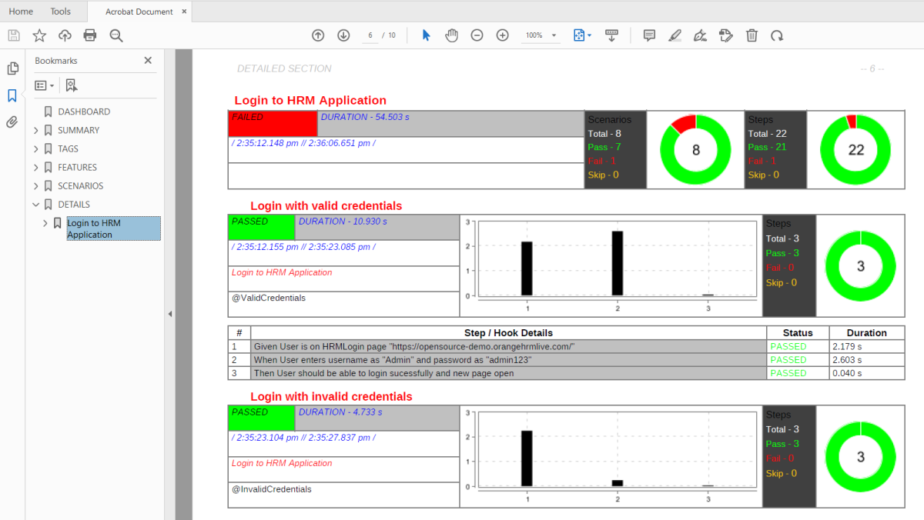
6. Detailed section
This section describes the details of individual steps and hooks, along with status and duration. This section display can be controlled by a configuration setting, enabled by default.

Slide 13
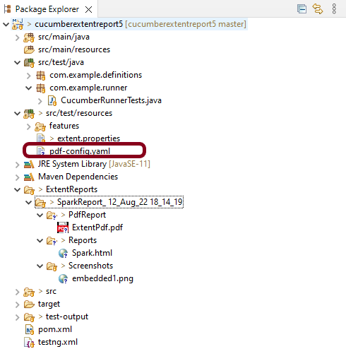
Customized PDF Report
The report settings can be used to toggle on and off optional report sections, and change the report title, text color for various data, background color, and other options.
The settings are saved in a YAML file called pdf-config.yaml, which is located in the project’s src/test/resources folder. If the file is missing or no settings are specified, the default values are used. To change the default values, create a pdf-config.yaml file in the project’s src/test/resources folder that contains only the new values for the settings.

Slide 14
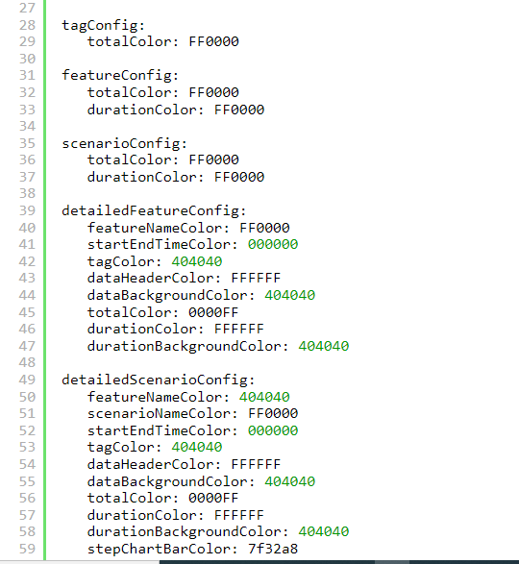
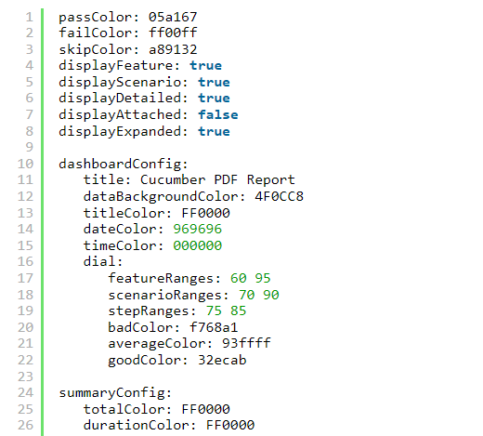
A sample YAML configuration file is shown below:

Slide 15
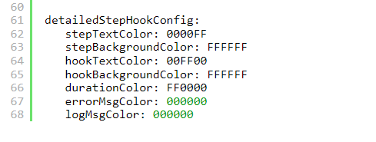
Execute the test code. Now the PDF Report will be generated as shown below:

Slide 16
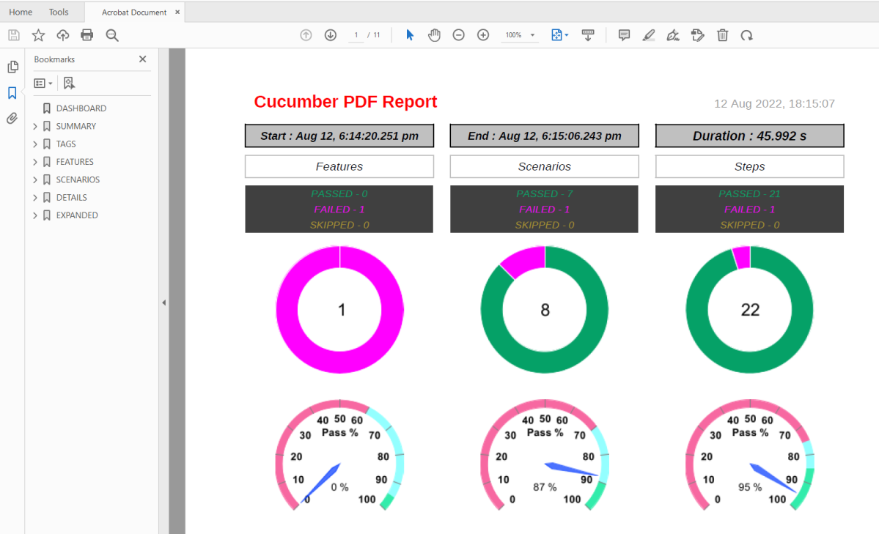

Slide 17
This method of configuring report settings using a yaml properties file can be used both for the Maven plugin report generation and the ExtentReport style.
The passed, failed, and skipped colors can be set with the passColor, failColor and skipColor properties. These take in the colors in hex values (without the leading ‘#’) and are valid throughout the report.
The features, scenarios, and detailed sections can be displayed by setting the displayFeature, displayScenario and displayDetailed properties to true. The default value for these settings is true.
Screenshots are displayed as thumbnails and can be opened in the available native application. This is the default behaviour, in which the screenshot file is embedded in the PDF file. This can be toggled by the displayAttached setting. When the setting is set to false, only the thumbnail is displayed. These can also be displayed in zoomed images in a separate section by setting the displayExpanded to true and also displayAttached to false.

